Slide 1
DORANet Workshop
Quan Zhang, Stefan Pate, William Sprague
Prof. Linda Broadbelt
Northwestern University
June 26, 2024

Slide 2
Background: CASP with DORAnet

Slide 3



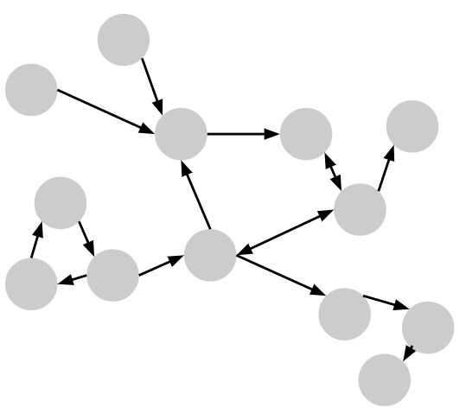
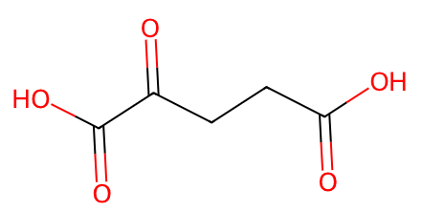
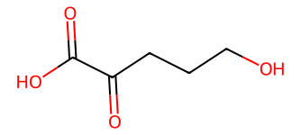
Overview of CASP with DORAnet
D
,
,
→
starting molecules
target molecules
operators

Slide 4
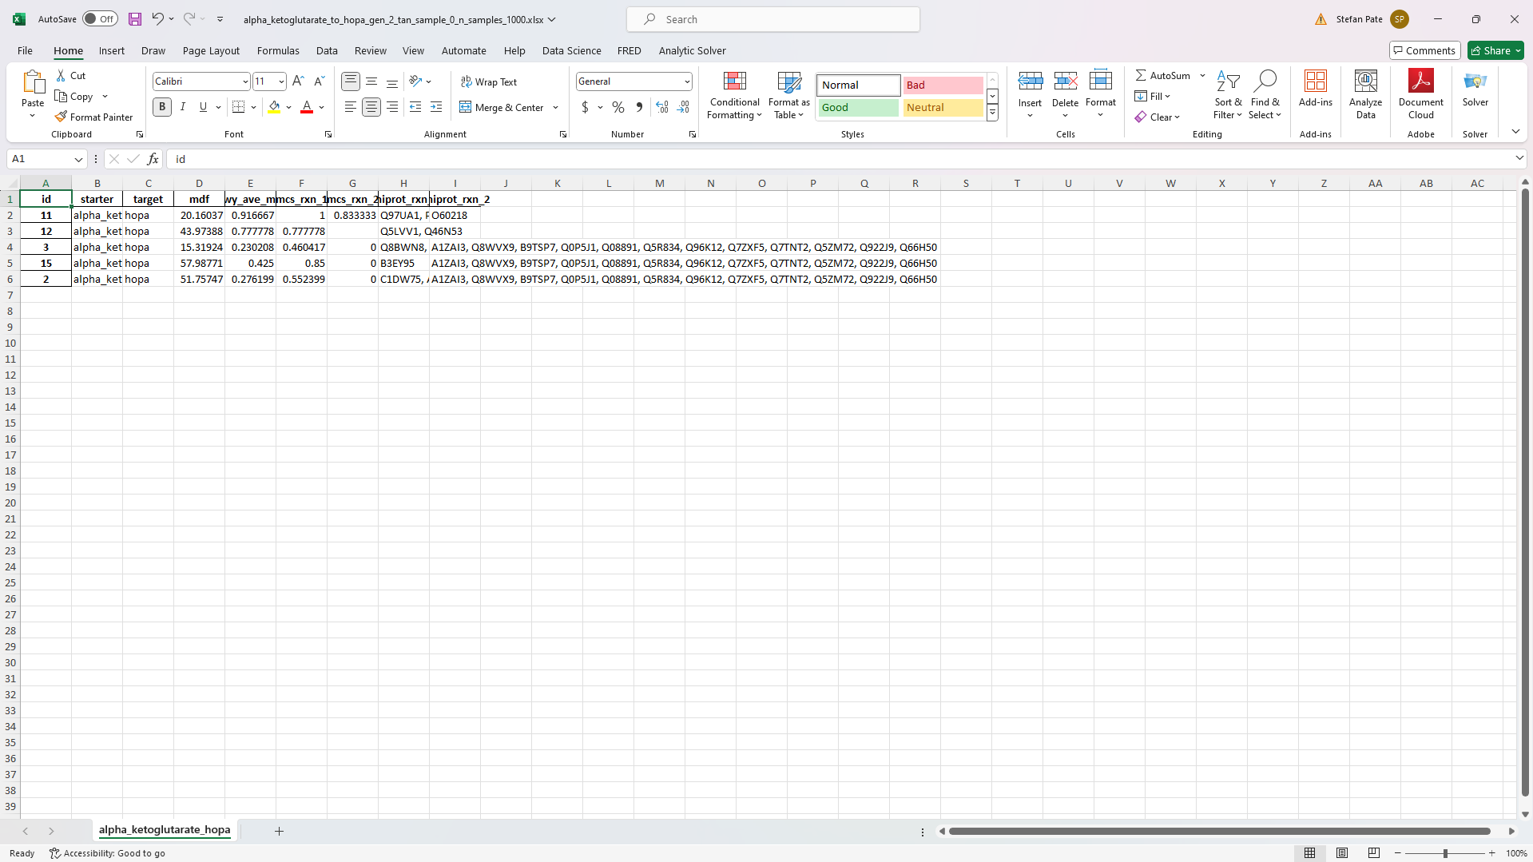
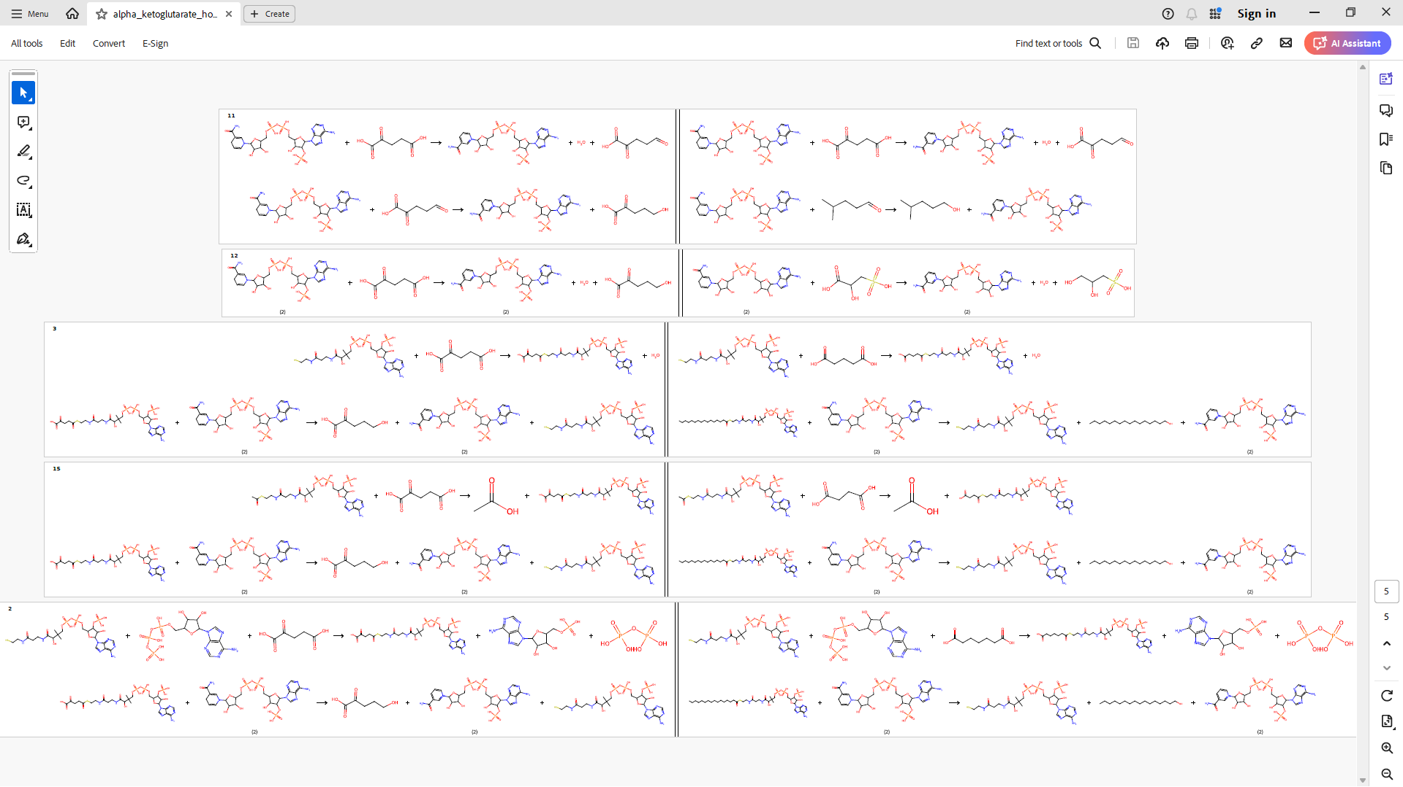
Overview of CASP with DORAnet
1
D
,
,
→
starting molecules
target molecules
operators
2
→
Filtering &
post-processing
→

Slide 5
Background: Operators

Slide 6
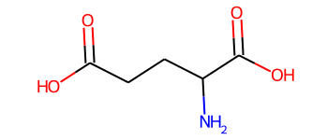
First, let’s consider CASP without operators
Glutamate synthase
(1.4.1.14)
This network of known enzymatic reactions is incomplete…

Slide 7
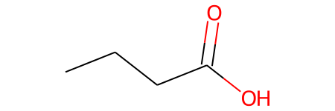
One-enzyme-one-substrate gives way to enzyme promiscuity
ILLUSTRATIVE
Enzyme: NICar
K_{cat} / K_{M}
Tawfik, 2010. Ann. Rev. Biochem.
Arnold, 2018. Ang. Chem. Int.

Slide 8
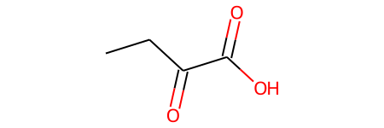
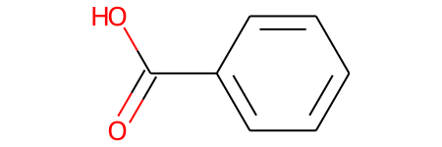
One-enzyme-one-substrate gives way to enzyme promiscuity
ILLUSTRATIVE
Enzyme: NICar
K_{cat} / K_{M}
Enzymes catalyze reactions on more than one substrate
Catalytic efficiency is similar for structurally similar substrates
Substrate structure
Tawfik, 2010. Ann. Rev. Biochem.
Arnold, 2018. Ang. Chem. Int.

Slide 9
One-enzyme-one-substrate gives way to enzyme promiscuity
ILLUSTRATIVE
Enzyme: NICar
K_{cat} / K_{M}
Enzymes catalyze reactions on more than one substrate
Catalytic efficiency is similar for structurally similar substrates
Substrate structure
Tawfik, 2010. Ann. Rev. Biochem.
Arnold, 2018. Ang. Chem. Int.

Slide 10
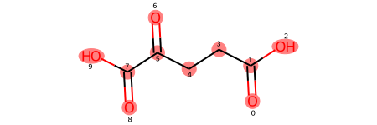
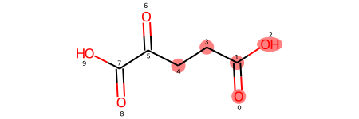
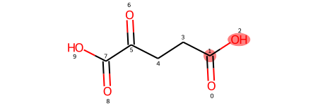
Enzymatic operators codify these two assumptions…
PERMISSIVENESS
CATALYTIC EFFICIENCY
r=inf
r=2
r=0
substructure:
# known compounds w/ matching substructure:
8
3,250
7,759

Slide 11
…allowing a search among predicted missing paths
Default enzymatic operators in DORAnet assume intermediate level of promiscuity

Slide 12
[Quan on construction of the chemical operators]

Slide 13
[Quan on forward versus retro & combination of both]

Slide 14
Demo: Network expansion

Slide 15
We’ll demonstrate DORAnet w/ 2 paths predicted for BOTTLE
Bio
(2 steps)
Chem
Placeholder Quan’s chem path to demo

Slide 16
Background: post-processing

Slide 17
We saw w/ just 2 steps how quickly the reaction count grows
Bio
156,000 reactions
(2 steps)
Chem
Placeholder Quan’s chem path to demo
xxxx reactions
Estimated average # of predicted reactions: 1,348 ± 91 for bio operators alone

Slide 18
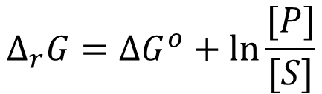
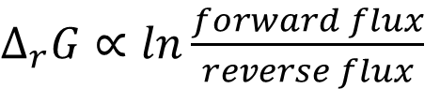
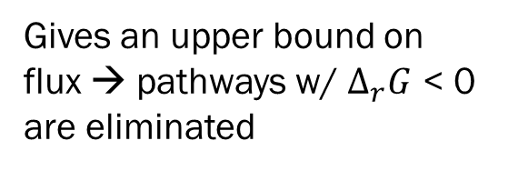
Most helpful filters: (1) thermodynamics
$Δ_{r}G∝ln\frac{forward flux}{reverse flux}$
$$Δ_{r}G=ΔG^{o}+ln⁡\frac{[P]}{[S]}$$
Gives an upper bound on flux → pathways w/ $Δ_{r}G$ < 0 are eliminated
Property of the substrates → estimate with group contribution theory
Function of substrate concentrations → optimize within physiological constraints
Noor et al., 2014. PLoS Comp. Bio.
Beard & Qian, 2007. PLoS ONE.

Slide 19
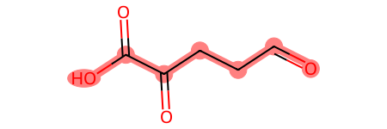
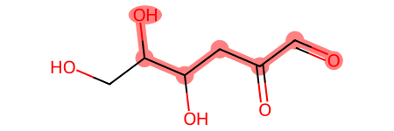
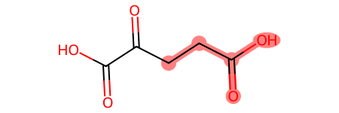
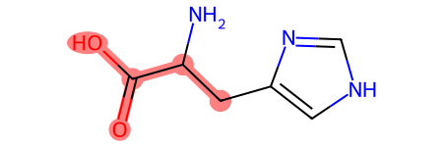
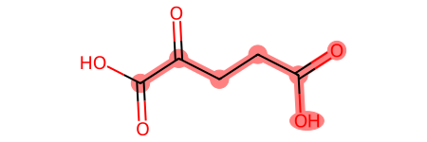
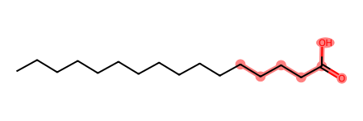
Most helpful filters: (2) structural similarity to known substrate
Predicted
Known
Reaction center MCS Score
vs.
0.64
vs.
0.45
vs.
0.39

Slide 20
Other information pulled from UniProt
Amino acid sequence
Organism
Level of evidence (protein, transcript, or homology)
EC number
UniProt ID

Slide 21
[Quan on his most useful filters]

Slide 22
Demo: Post-processing

Slide 23
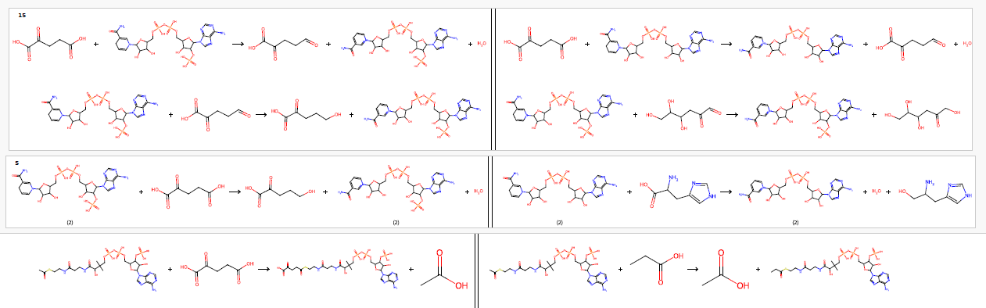
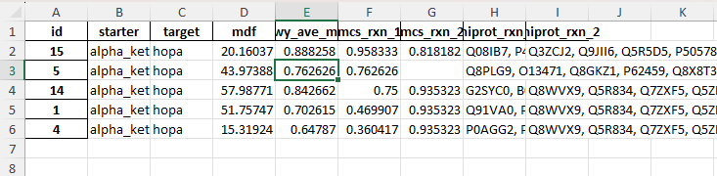
Final output documents
Side-by-side reaction drawings (.pdf)
More info on pathways (.xls)
One pathway
UniProt IDs to access more info
Predicted reaction
Known reaction
Soon this post-processing will be incorporated into DORA so you can customize it

Slide 24
[High level overview of Quan’s chemical filtering]

Slide 25
Coming soon: [Hybrid pathways, kinetics…]

Slide 26
[William highlight new things in development]

Slide 27
Questions

Slide 28
Backup

Slide 29
Installation: DORAnet

Slide 30
Virtual Environment
Miniconda or Anaconda Installation
Download the installer
Miniconda https://docs.anaconda.com/free/miniconda/
Anaconda https://docs.anaconda.com/free/anaconda/install/
Run the installer
Follow the on-screen instructions
Use conda with command line
Linux and mac: open the built-in terminal
Windows: open the Anaconda Powershell Prompt

Slide 31
Create and Activate an Environment
If you already have an environment to install DORAnet
If you want to create a new environment to install DORAnet
conda activate your_env_name
conda create -n your_env_name python=3.10
conda activate your_env_name

Slide 32
Install DORAnet
Install
Update DORAnet (In the Future)
pip install doranet
pip install doranet --upgrade

